Slide 1
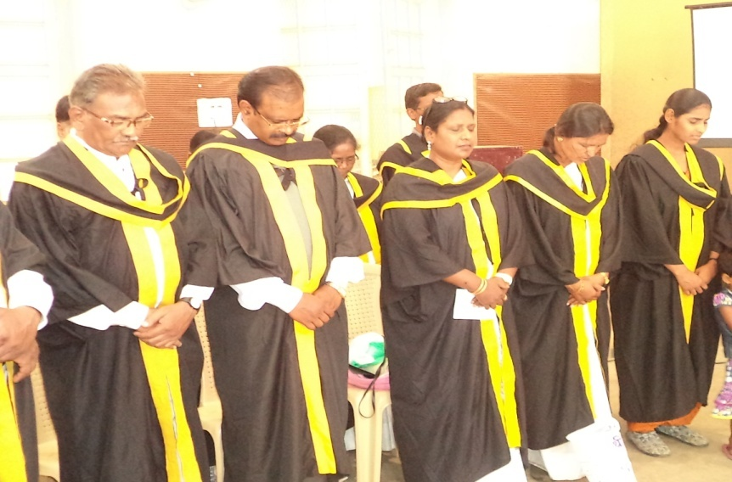
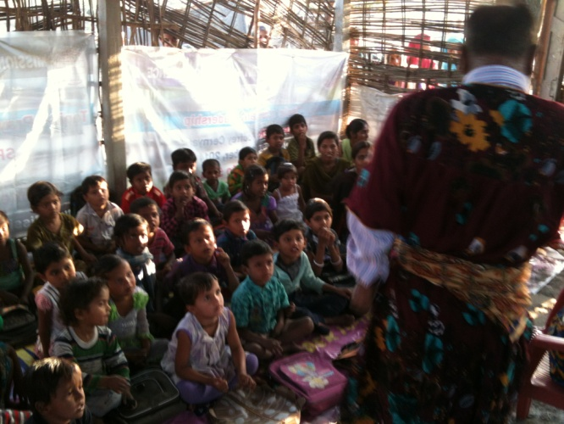
Vocational and Slum Links
EA Training Commission
Vocational Training
TUL Training
Praxis in the Slum

